Slide 1
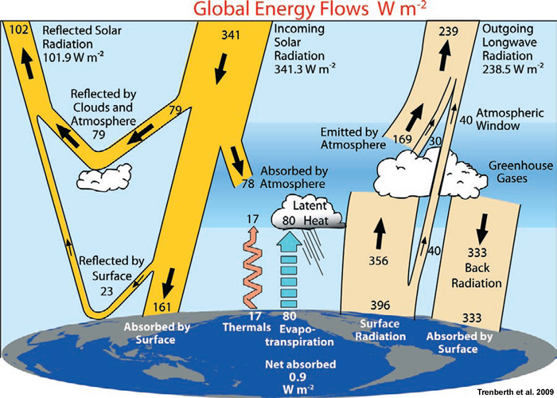
Global Energy Balance
Note that these values are globally- and temporally-averaged; they are not meant to represent any one location on any given day.
Figure from Introduction to Tropical Meteorology (Ch. 1) by the COMET Program

Slide 2
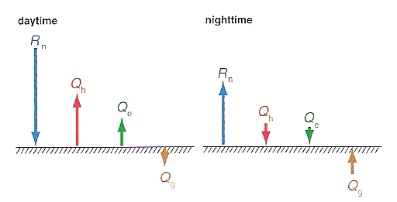
Surface Energy Budget
Figure 4.8, Markowski and Richardson (2010)

Slide 3
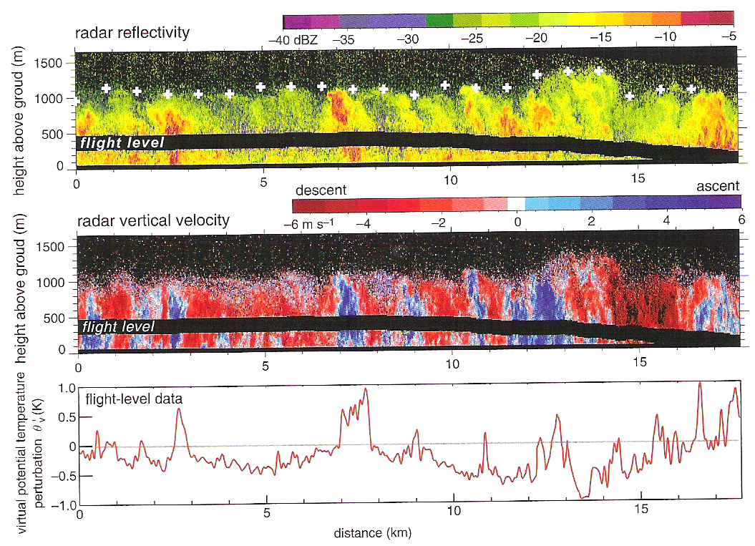
Planetary Boundary Layer Structure
Figure 4.1, Markowski and Richardson (2010)

Slide 4
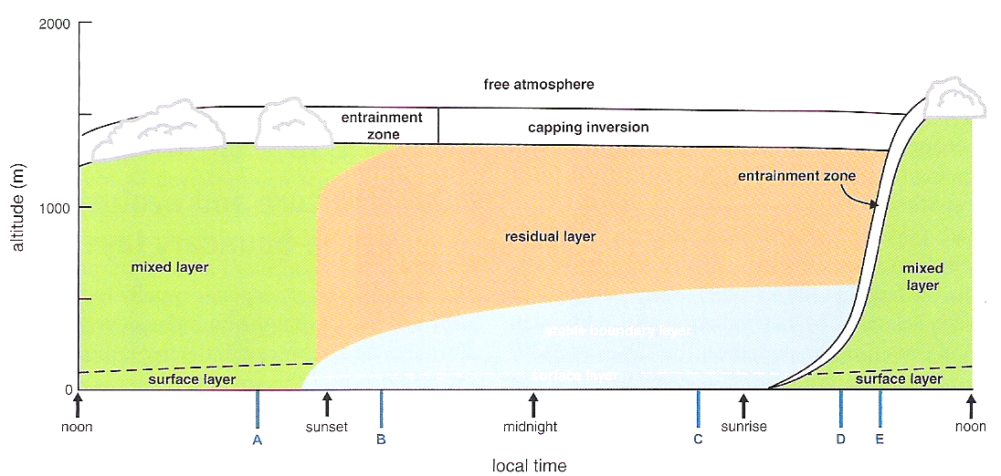
Planetary Boundary Layer Structure
Figure 4.9, Markowski and Richardson (2010)

Slide 5
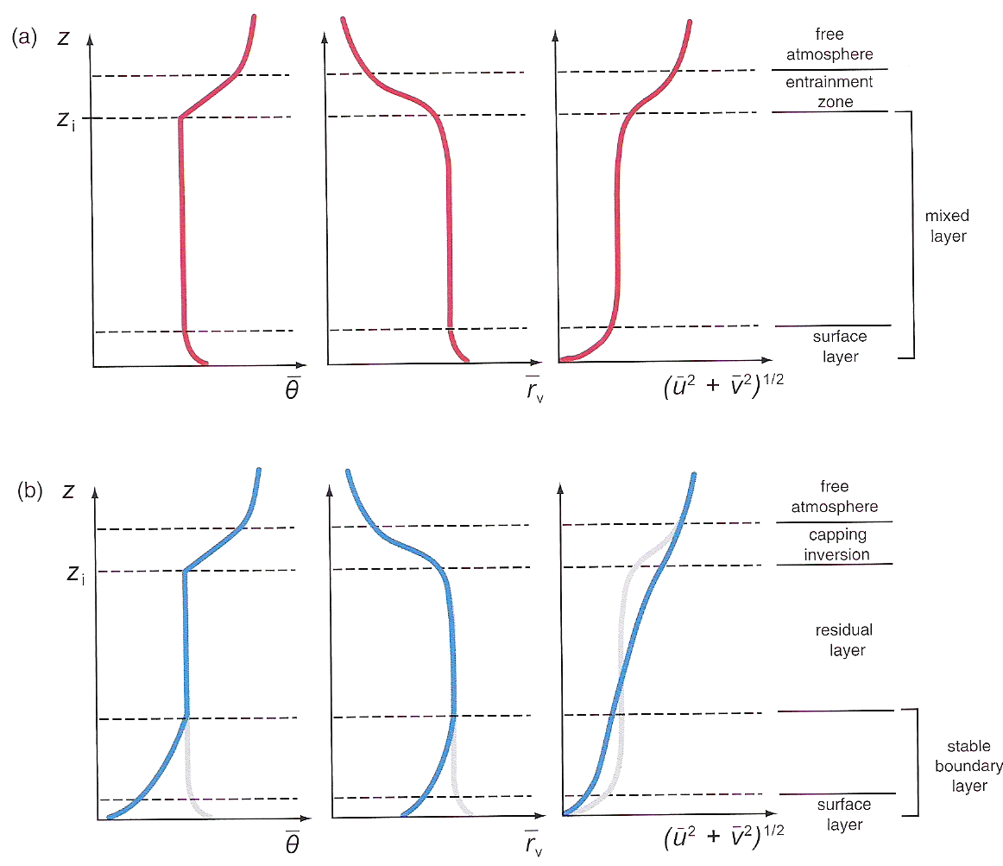
Boundary Layer Vertical Profiles
Figure 4.11, Markowski and Richardson (2010)

Slide 6
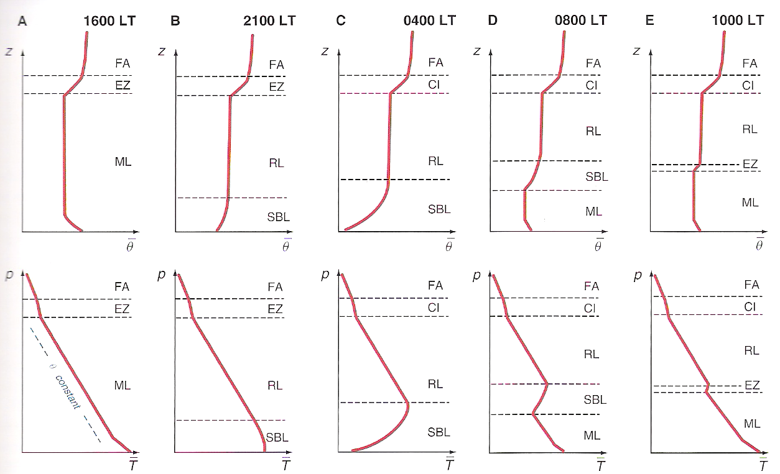
Boundary Layer Vertical Profiles
Figure 4.10, Markowski and Richardson (2010)

Slide 7
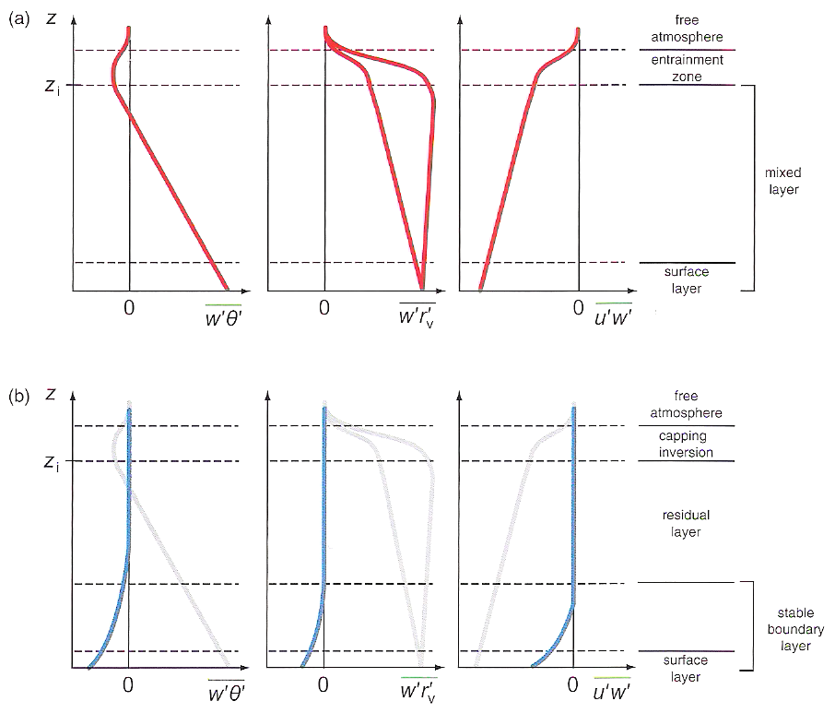
Vertical Turbulent Flux Profiles
Figure 4.2, Markowski and Richardson (2010)

Slide 8
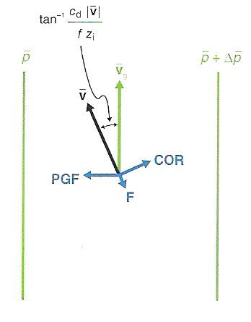
Frictional Effects on Boundary Layer Wind
Figure 4.6, Markowski and Richardson (2010)

Slide 9
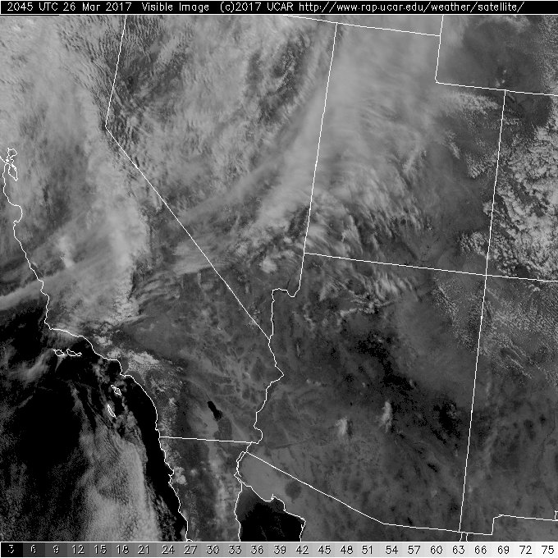
Cellular Convection
Here, closed-cell convection is found south of Los Angeles over relatively cool waters compared to the overlying air.
It is commonly found in synoptically-benign conditions, such as beneath anticyclones, and generally only over water.
Image from http://weather.ral.ucar.edu/satellite/

Slide 10
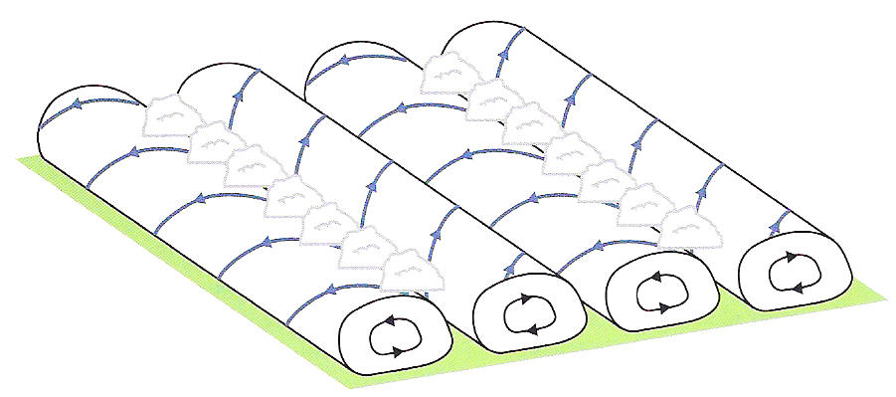
Horizontal Convective Rolls
Figure 4.15, Markowski and Richardson (2010)

Slide 11
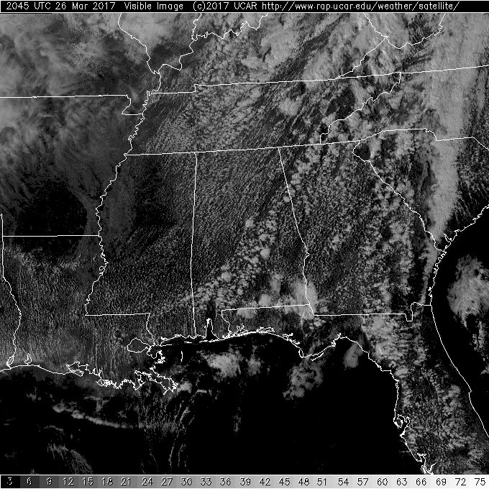
Horizontal Convective Rolls
Roughly evenly-spaced, aligned along (or nearly so) the mean boundary layer wind.
Deep, moist convection can occur along the ascending branch if sufficient instability and lift exist.
Image from http://weather.ral.ucar.edu/satellite/

Slide 12
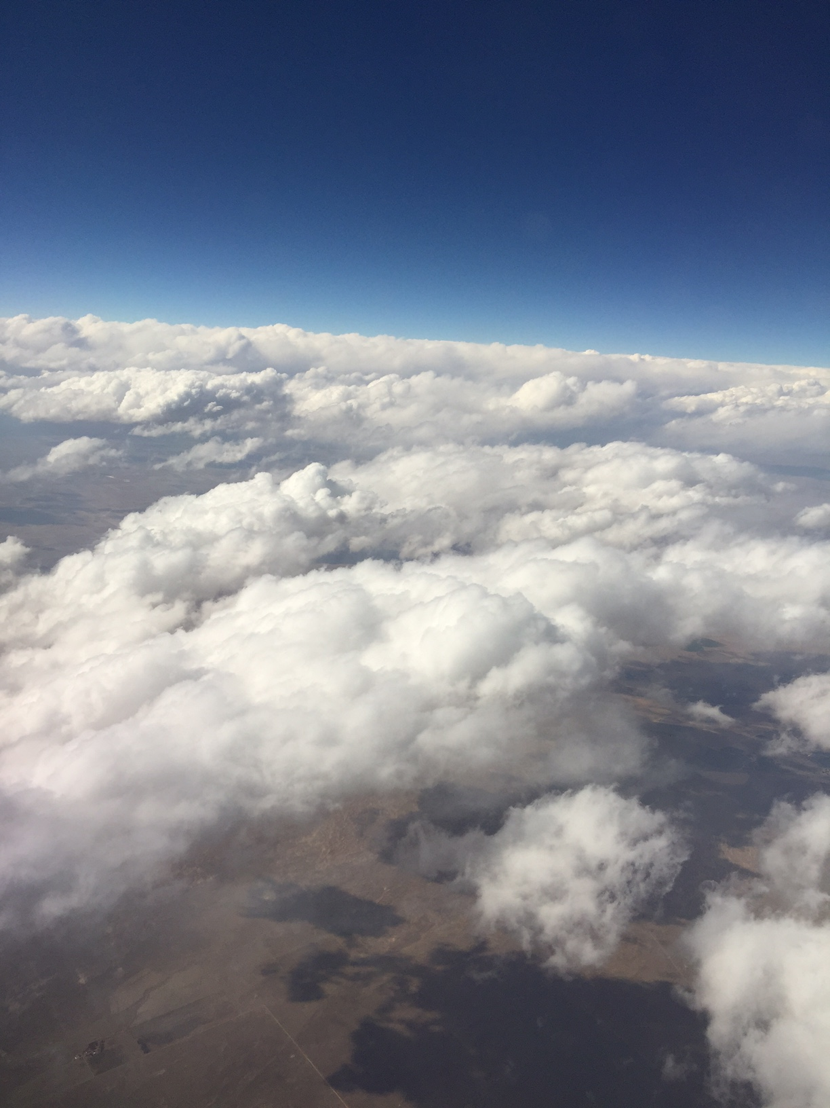
Cloud Streets
The planetary boundary layer wind on this day was generally out of the southwest. This photo is looking just west of north.
Each cloud street is nearly aligned with the mean boundary layer wind and represents an HCR’s ascending branch.
Taken over far southwest Nebraska, 23 March 2017

